Slide 1
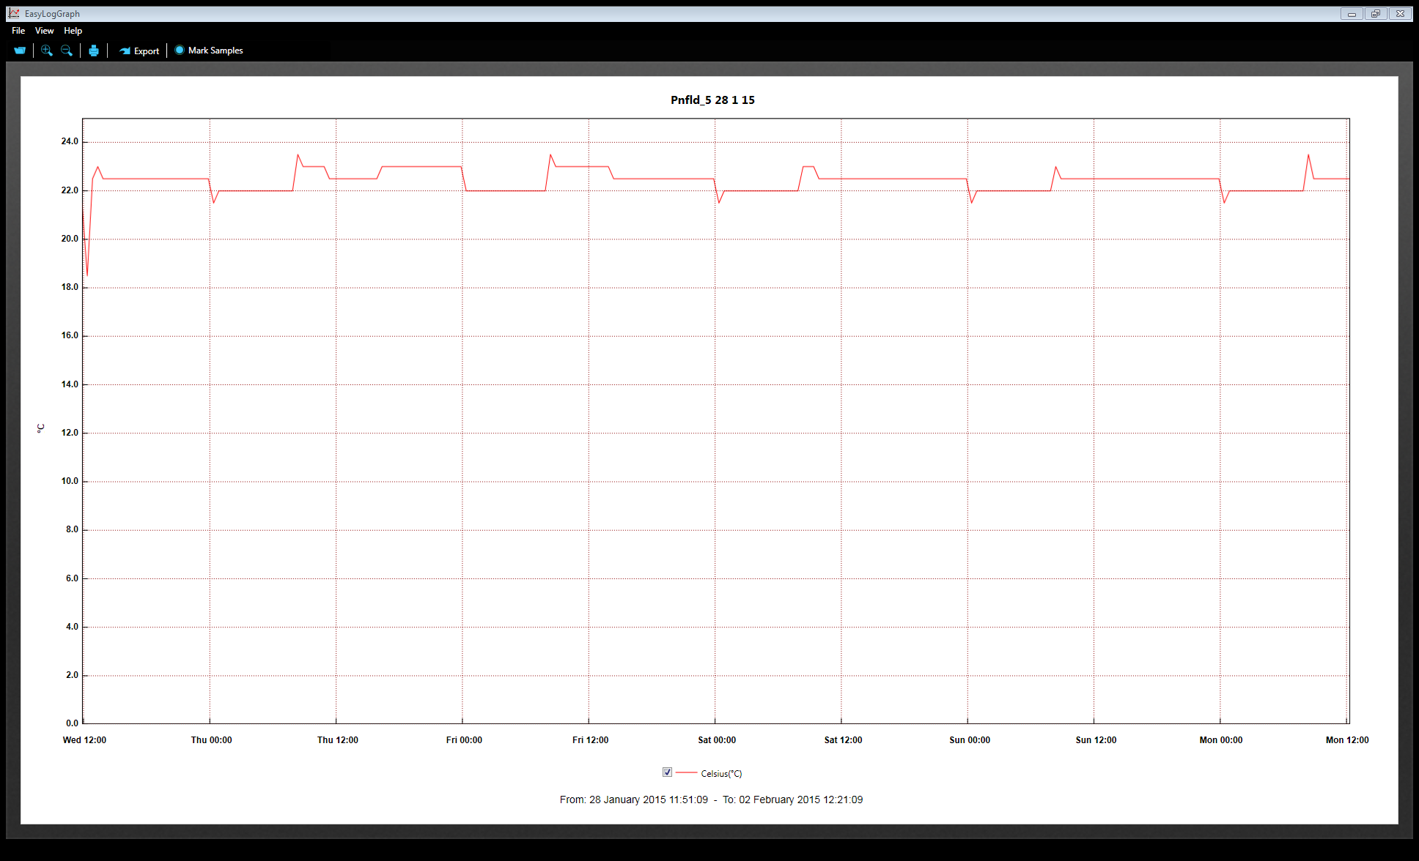
Cabinet #12 set to 22oC LD

Slide 2
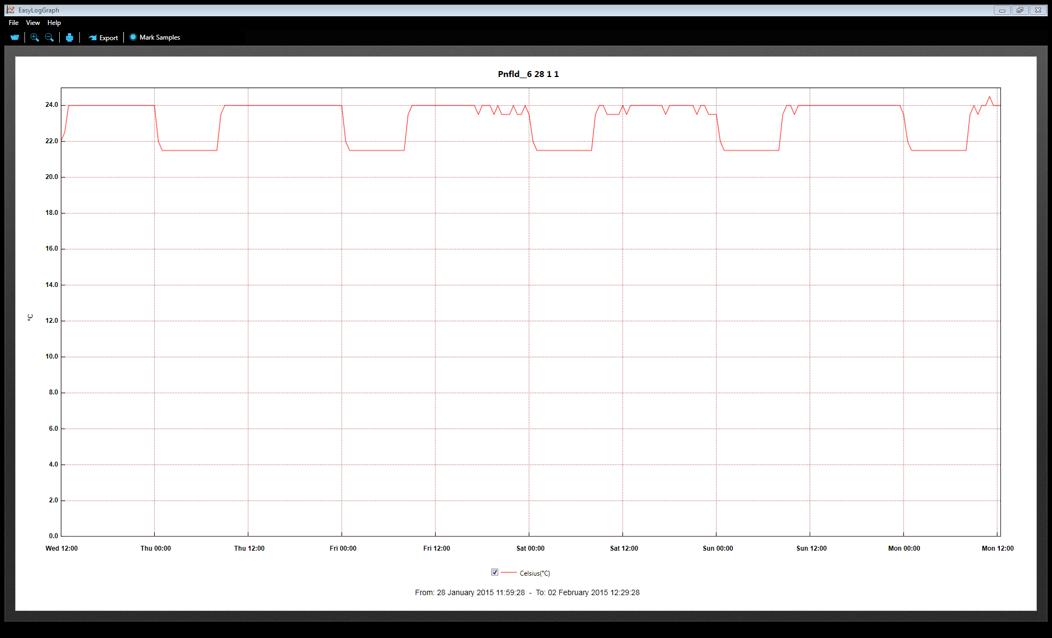
Cabinet #2 set to 22C

